Slide 1
A Introduction to Kinect
Section 1

Slide 2
Topics
Introducing Microsoft Kinect
The Kinect sensor on the Xbox 360
The Kinect sensor on the Windows PC
Inside the Kinect Sensor Bar
Video camera
Depth camera
Sound input
Connecting the Sensor Bar
The Kinect for Windows SDK

Slide 3
1.1 Introducing Microsoft Kinect

Slide 4
The Kinect for Xbox 360
Microsoft Kinect was released in 2011 as a new kind of controller for the Xbox 360
More than 8 million Kinects were sold in the 60 days after its launch
It is the “fastest selling gadget ever”
Verified by the Guinness Book of Records
Great Kinect games include “Kinect Sports”, “Dance Central 2” and “Gunstringer”

Slide 5
Why is Kinect special?
The Kinect brings together three sensors
Video – high resolution webcam
Audio – four high quality microphones
Depth – infra-red “depth camera”
The third sensor is the most interesting
It allows a computer to detect the position and orientation of objects in front of the sensor
This is used by the Kinect for Windows SDK to track the skeleton of human game players

Slide 6
Kinect Connection
The Kinect uses a Universal Serial Bus (USB) connection
This connection is available on the Xbox 360 console and the Windows PC
It is physically very easy to plug a Kinect sensor into a Windows PC
As long as you use the Kinect sensor power supply correctly

Slide 7
The Kinect for Xbox 360 sensor
The Kinect for Xbox 360 sensor is optimised for game play
It has long cables to allow placement in a domestic setting
Configured to locate and track game players
It can be used with the Kinect for Windows SDK
If you are developing a PC based product this should target the Kinect for Windows device

Slide 8
The Kinect for Windows sensor
The Kinect for Windows sensor is optimised for PC use
Shorter cables for desktop deployment
Configured to allow short range use
Can track a single user as close as 40cm
Intended as the basis of Kinect applications running on Windows PC

Slide 9
The Kinect for Windows SDK
The Microsoft Kinect for Windows SDK was released on February 1st 2012
Contains the USB drivers for the Kinect sensor on a Windows PC
Provides an application programmer interface (API) which allows software to use the sensor
Can be used from “unmanaged” C++ and “managed” Visual Basic .NET and C# applications

Slide 10
Managed and Unmanaged code
C# programs run in a “managed code” environment
The managed code environment stops them from doing the wrong thing when they run
The environment also provides services such as garbage collection
However, there is a performance penalty for this extra work which can slow managed programs down slightly

Slide 11
Unmanaged C++ applications
Unmanaged code is allowed more direct access to the underlying hardware and can be customised for particular processor types
Unmanaged code can run more quickly than managed code but it must do more work itself
However, if a program running as unmanaged code fails it is much harder to find out what went wrong

Slide 12
Using Managed Code
We are going to use Managed Code for this course
We are going to use C# and XNA
We will find that a modern computer can run quite fast enough to give a good user experience using this managed code
The examples can be converted to unmanaged code if you wish to do this

Slide 13
The Kinect for Windows SDK
The Kinect for Windows SDK is a free download from http://kinectforwindows.org/
The SDK be used with the Xbox 360 sensor to create programs for “hobbyist” or academic/research purposes
However, PC software for sale should be based on the Kinect for Windows sensor

Slide 14
1.2 Inside a Kinect Sensor Bar

Slide 15
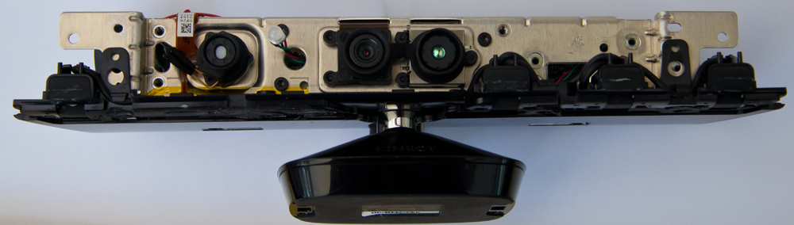
Inside a Kinect Sensor
The Kinect contains two cameras, an infra-red projector and four microphones
It allows programs to interact with the user in a much more natural way
Software can use video, sound and gesture recognition driven interactions

Slide 16
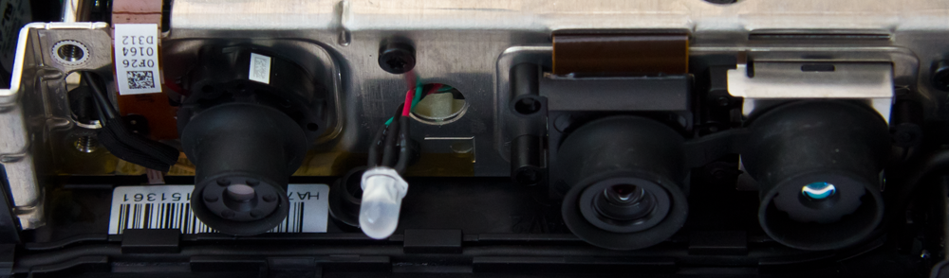
The Kinect Video Camera
Video Camera
The Kinect sensor contains a high quality video camera which can provide up to 1280x1024 resolution
It can also be used as a webcam

Slide 17
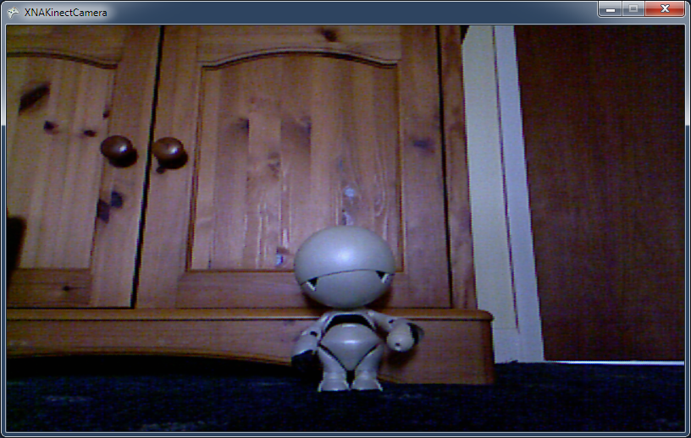
Demo
1 Kinect video output
Notes:
For this demonstration to work you must have installed the Kinect for Windows SDK. You must also have a Kinect sensor plugged into the USB Port on your computer.
Start Visual Studio 2010
Open the project KinectCam in the 01 XNAKinectCameraDemo demo folder.
Run the program by pressing F5.
The program will start running and will display the video output on the screen.
Stop the program by selecting Debug>Stop Debugging
Open the source file KinectCameraGame.cs
Navigate to the method Draw
Remind everyone that this is the XNA method that draws the image when the game updates.
Show that this method checks to see if the kinectVideoTexture exists and draws it if it does.
Explain that this texture is created from the Kinect camera (we shall see how later on) and then rendered in the usual way.
Find the statement spriteBatch.Draw(kinectVideoTexture, videoDisplayRectangle, Color.White);
Ask what would happen if the color was changed to Color.Red.
Answer: The red parts of the image would be drawn.
Change the color and run the program again.
Make the point that everything you can do with an XNA texture (scaling, transforming etc) the game can do with this texture.
Stop the program and exit Visual Studio.

Slide 18
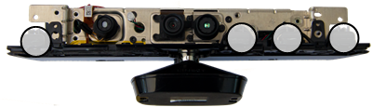
The Kinect Microphone Array
microphone array
The Kinect sensor contains four microphones
These are not provided for multi-channel recording (e.g. stereo)
Instead they allow the sensor to perform sound isolation and echo removal

Slide 19
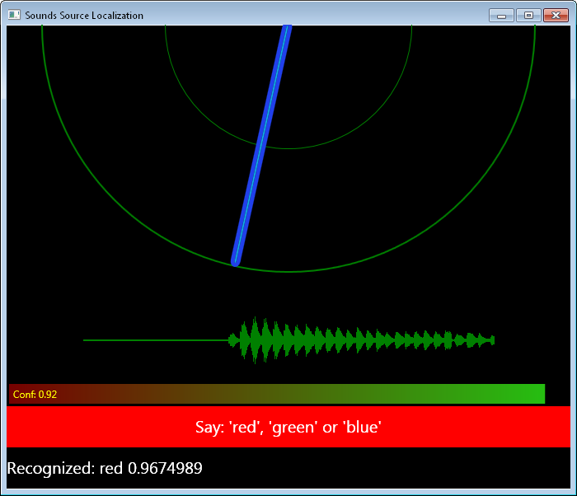
Demo
2 Kinect Audio Demo Application
Notes:
For this demonstration to work you must have installed the Kinect for Windows SDK. You must also have a Kinect sensor plugged into the USB Port on your computer. The demonstration works best if the sensor is facing the audience.
Press Start and open the All Programs.
Open the Microsoft Kinect SDK v1.0 program group.
Select the program Kinect SDK Sample Browser and run it.
Make the point that there are a lot of useful samples here, and that all the code is provided for each of them.
Scroll down to Kinect Audio Demo and click Run Sample
Ask different people in the room to shout color names and show how the pointer moves to them.
Exit the program and exit the sample browser.

Slide 20
The Kinect Depth Camera
IR Projector
IR Camera
The Kinect sensor contains an infra-red (IR) projector that “sprays” the objects in front of the sensor with dots of infra-red light
The camera looks at where each of these dots appears in the scene

Slide 21
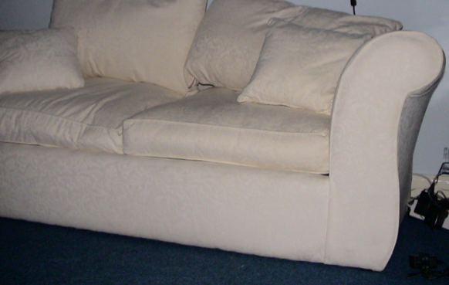
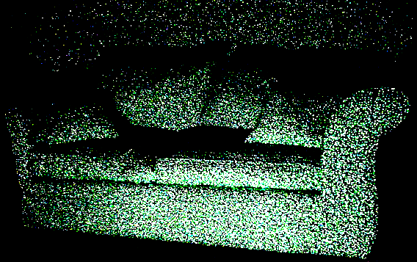
The Kinect’s depth view of the world
The Kinect sensor projects a grid of infra-red dots onto the scene in front of it
By working out the displacement of each dot as it is reflected the sensor can work out the distance to that point in the scene

Slide 22

Decoding the Dots
The pattern of dots that is used to measure depth may look random but it is repeatable
The further away the dot is reflected, the more it is displaced in the image the camera sees

Slide 23
Decoding the Dots
The dots on the front of the arm are closer together than the dots on the left at the back
The sensor uses this change to work out the distance of each part of the scene from the camera

Slide 24
Depth Camera Limitations
Because of the way the camera works some parts of the scene will be in “shadow” and their distance can’t be measured
These are shown as having a distance value of 0
The camera only works for objects more than 80cm away from the sensor
The resolution of the camera reduces as objects get further away from the sensor
Notes:
Make the point that the sensor knows the direction of each dot that is being sent, and so it can work out the reflection that would be produced for objects different distances away.

Slide 25
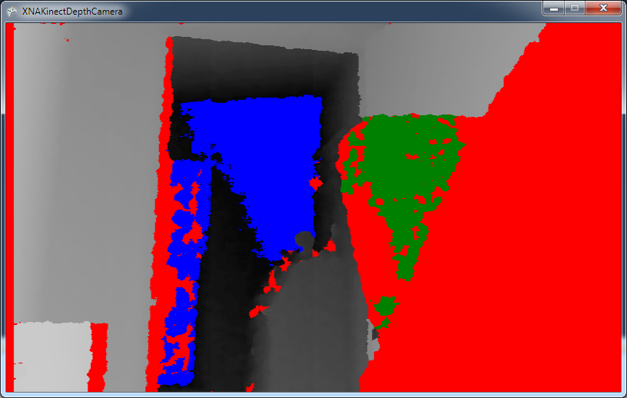
Demo
3 Kinect Depth Demo Application
Notes:
For this demonstration to work you must have installed the Kinect for Windows SDK. You must also have a Kinect sensor plugged into the USB Port on your computer. The demonstration works best if the sensor is facing the audience.
Start Visual Studio 2010
Open the project XNAKinectDepthCamera in the 03 XNAKinectDepthCamera Demo demo folder.
Run the program by pressing F5.
The program will start running and will display the depth output on the screen.
Explain that the darker the object the further away from the sensor it is.
Explain that pixels are coloured as follows: red – depth can’t be determined blue – too far away green – too close to the sensor
Demonstrate this by moving your hand slowly towards the sensor from a distance of around 2 meters and show how the hand changes colour
Stop the program by selecting Debug>Stop Debugging
Exit from Visual Studio

Slide 26
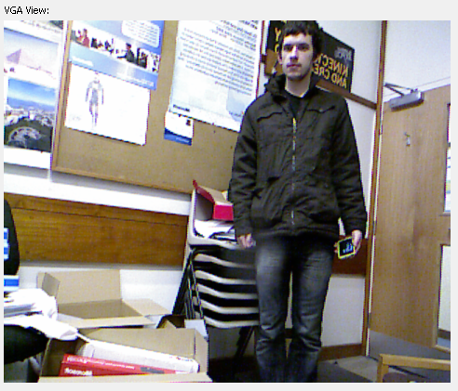
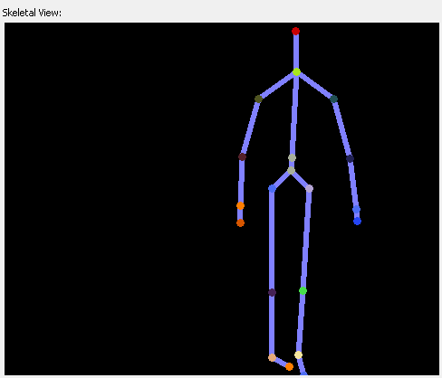
Kinect Skeleton Tracking
A program can use the view from the depth sensor to isolate a human body shape from a scene and directly interpret human movement and gesture
We can create programs that use this information

Slide 27
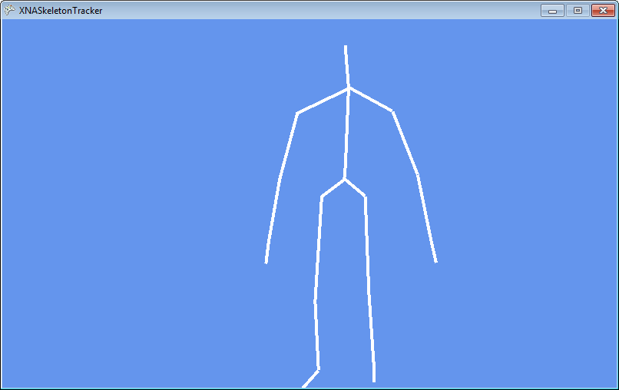
Demo
4 Skeleton Tracking Demonstration
Notes:
For this demonstration to work you must have installed the Kinect for Windows SDK. You must also have a Kinect sensor plugged into the USB Port on your computer. The demonstration works best if the sensor is facing the audience.
Start Visual Studio 2010
Open the project XNASkeletonTracker in 04 Kinect Skeleton Display demo folder.
Run the program by pressing F5.
The program will start running and will display a blue screen.
Ask someone to walk in front of the sensor.
The program will display their skeleton.
Stop the program.
Open the source file SkeletonGame.cs
Navigate to the drawSkeleton method.
Show that the skeleton is created by drawing bones that link the body joints.
Explain that each joint is positioned in 3D space, but is mapped into 2D for drawing. Make the point that we will see how this works a bit later.

Slide 28
Kinect Skeleton Detection
The Kinect SDK can track up to six people in a scene
Four people are tracked in terms of their position
Two people are accurately tracked, with 20 joint position values being provided by the SDK
The software will infer the position of joints that are not immediately visible
If the person is wearing a dress or skirt that obscures their limbs

Slide 29
Connecting the sensor bar
The sensor bar uses a USB 2.0 connection to the host computer
It is best if it has exclusive use of a connection as it transfers quite a lot of data
Do not plug the sensor into a USB hub along with lots of other devices
The Kinect sensor bar also needs its own power supply, it cannot be directly powered from the USB connection

Slide 30
PC Requirements
The Kinect for Windows SDK requires a machine with a dual core processor running at 2.66 GHz or more (32 bit or 64 bit) with 2G of ram
It uses Visual Studio 2010 and the .NET framework version 4.0
For speech applications you will also need to install the Microsoft Speech Platform SDK version 11

Slide 31
1.3 The Kinect SDK

Slide 32
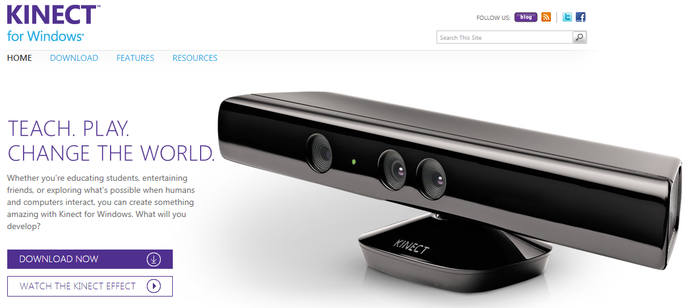
Obtaining the Kinect SDK
The Kinect for Windows SDK is a free download from the Kinect web site
http://kinectforwindows.org/
This installers the SDK, USB drivers, sample code and documentation

Slide 33
The Kinect for Windows SDK
The Kinect for Windows SDK is provided as a set of libraries that are used to interact with the sensor bar
There are versions of the libraries for unmanaged (C++) and managed (C# and VB.NET) code
This material is going to focus on the use of the Kinect SDK in managed XNA games

Slide 34
Optimal Installation Sequence
Remove old software and drivers
Ensure that your Kinect sensor firmware is up to date (connect to an Xbox 360)
Install the Kinect SDK
Plug the Kinect sensor into your PC
Install the Microsoft Speech Platform components
Run the audio and skeleton demos

Slide 35
Summary
The Kinect was originally launched as a game controller for the Xbox 360 but it is now being provided for Windows PCs
The Kinect for Windows SDK provides the USB drivers and a library of drivers for managed and unmanaged code access to the Kinect Sensor bar hardware
If you wish to sell programs that use the Kinect SDK you must base them on the Kinect for Windows sensor
The Kinect sensor bar contains four microphones, a video camera and an infra-red “depth” camera
The Kinect SDK is a free download which provides libraries that give access to the Kinect from managed and unmanaged code on a Windows PC

